Slide 1
SL Project
Ma Ka Kui

Slide 2
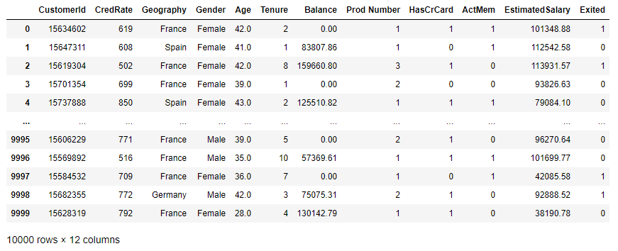
Scenario
Given set data, predict customer churn, i.e. Exited

Slide 3
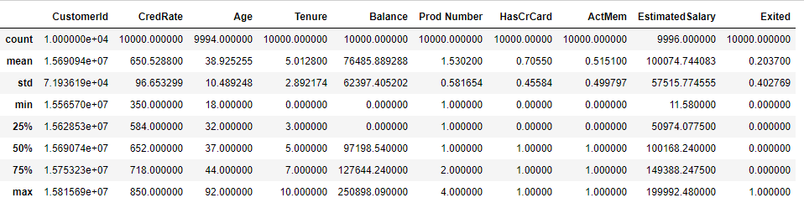
Data preprocessing
Can drop CustomerId, not interested in it
Balance has weird distribution, where min = 25% = 0
Other columns have missing values, e.g. Age has 6 missing values

Slide 4
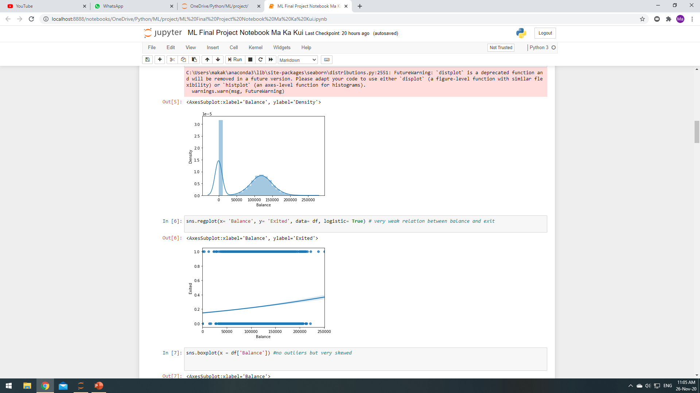
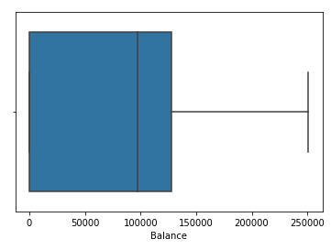
More on Balance
Balance has a large number of zeros, and these do not correlate to churn well.
Therefore, we drop Balance column.

Slide 5
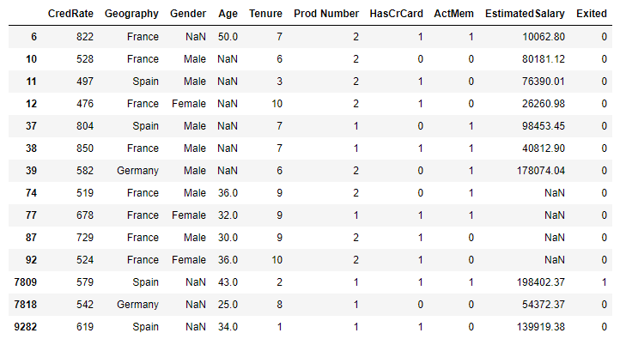
Missing values
14 rows out of 10000 rows with missing values
Mostly missing Age or EstimatedSalary
Dropped rows since 14/10000 is not significant loss of data

Slide 6
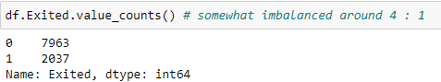
Churn counts
Churn vs not churn is 1:4.
Ideally should be balanced (Solution on next slide)
On flip side, it is good news since only 20% churn.

Slide 7
SMOTE for imbalanced data
Synthetic Minority Oversampling Technique (SMOTE)
Balance Churn vs non-Churn synthetically
Only performed on training data set

Slide 8
Machine Learning
Trained models using 75% of data, and tested with remaining 25%
Success of model based on AUC-ROC score, which roughly translates to probability that the model can predict churning.
If score ≈ 1, means can predict with 100% certainty
If score = 0.5, means as good as coin flip
Score must be > 0.5 for success

Slide 9
Results
Random Forest : 0.734
XGBoost : 0.734
AdaBoost: 0.718
Logistic Regression : 0.645
Naïve Bayes: 0.665
K Nearest Neighbors : 0.651 (k =6)
SVC : 0.725
Models have been optimized to achieve best scores.
Consider random forest which has good score, simple and robust

Slide 10
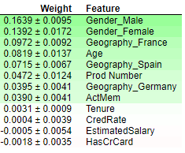
ELI5 (Explain like I’m 5)
ELI5 package used to determine important features (based on test set)
Apart from gender and geography which appears to be almost equally weighted (and thus actually not important), Age appear to have most weight
Possibly due to older customers cashing out for retirement

Slide 11
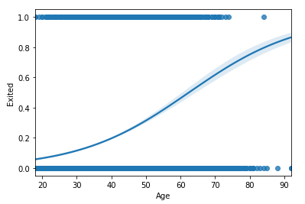
Churning Age
Using Logistic Regression, we find that at around age 60, customers likely to churn
No clear indicators for other features.

Slide 12
Conclusion
No one feature able to predict with complete certainty to churn
Churning age only an estimate
Balance needs more investigation as to large number of zeroes
Random Forest chosen for its simplicity and sufficiently high score
May need more data to improve model

